Slide 1
MESC 2025 MITA Governance Meeting: General Updates
August 13, 2025, 3:00 – 3:50 PM CT

Slide 2

Welcome and Thank You!
Ed Dolly, Deputy Director
CMS Data & Systems Group
Alejandra Johnson, Technical Director
Chair, MITA Governance Board
CMS Data & Systems Group
Division of State Services

Slide 3
AGENDA
Subject | Presenter | Timing
Introduction / Overview of MITA Governance Board | Alejandra Johnson | 3:00 – 3:10 PM
Menti Poll | Team | 3:10 – 3:15 PM
NextGen Workgroup | Jess Groeling | 3:15 – 3:25 PM
SS-A Workgroup | Kiera Bentley | 3:25 – 3:33 PM
Communications Workgroup | Nicolle Field | 3:33 – 3:40 PM
Next Steps / Questions | Alejandra Johnson | 3:40 – 3:50 PM

Slide 4
MITA and the MITA Governance Board
The MITA Governance Board (MGB) began reconvening at HIT Connect in April 2023 to reinvigorate MITA and established several work groups to begin working on the next generation of MITA and the SS-A.
The MGB’s primary goal is to provide guidance to work groups as they develop MITA 4.0 in accordance with CMS' goals for MITA:
Make MITA more meaningful
Reduce burden on SMAs
Enable automation
Tighten integration with APD, Certification and other MES activities
Release guidance that is aligned with current trends in healthcare and IT
The MGB established a new vision for MITA:
The Medicaid Information Technology Architecture (MITA) supports the achievement of Program goals and objectives to better serve stakeholders and promote greater efficiencies towards compliance and the administration and operation of the Medicaid Enterprise System (MES).

Slide 5
MITA 4.0 Timeline
MESC 2025
MESC 2026
Q3 2025 | Q4 2025 | Q1 2026 | Q2 2026 | Q3 2026
Planning for conducting user testing and pilot materials with select states
Incorporate user testing and pilot feedback and continue developing additional iterations of MITA 4.0 framework and technical assistance resources, and continue to build out prototype SS-A Tool
Introduce MITA 4.0 framework, technical assistance resources, and prototype
SS-A Tool at MESC 2026
Drafting initial iteration of MITA 4.0 framework, technical assistance resources, and prototype SS-A Tool

Slide 6
MITA Governance Board Members 2025 - 2027
Abigail Viall
Alejandra Johnson
Alicia Dyer
Christine Nolan
Diane Twehous
Ed Dolly
Erin Coleman
Eugene Gabriyelov
Jason Kelly
Jeff Strand
Jerilyn Grow
Jessica Groeling*
Kathleen Walsh
Kendal Scheidt
Kiera Bentley*
LaQuita Kelly-Allen
Lisa Alger
Michael Collisi
Nicholas Mozer
Nicolle Field*
Vivian de la Gandara
Zachary Rioux*
* Workgroup/stream Lead

Slide 7
MITA Governance Board Sponsored Workgroups
MITA NextGen
Advancing the MITA framework by evaluating and enhancing MITA 3.0 components for inclusion in MITA 4.0.
SS-A
Developing a prototype tool for conducting the SS-A and leading the redesign of the SS-A process to be outcome-based, less burdensome, and more valuable to states and CMS.
Promoting interoperability and open standards (e.g., FHIR) using the MITA Technical and Information Architectures. Offers guidance to SMAs for regulatory compliance.
Developing a guide on the Outcomes-based Planning Process.
Collaborating with NextGen on a new Maturity Model framework for MITA 4.0.
Communications
Drives awareness and engagement around MITA 4.0 through newsletters, repository updates, and publishing strategies to inform stakeholders and share new materials.

Slide 8
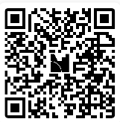
MENTI POLL
Live Poll – Join In!
Go to www.menti.com and enter the code: 7134 2112 OR Scan the QR code to join the live quiz

Slide 9
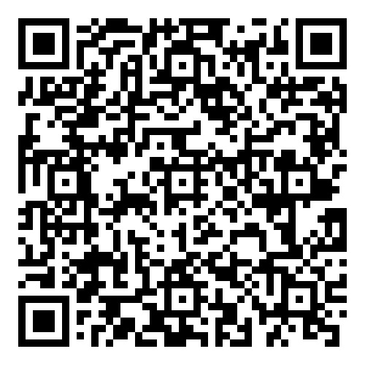
Scan the QR code to access the MITA GitHub site to learn more about MITA and keep up to date on MITA 4.0
Send questions and feedback to MITAGovBoard@cms.hhs.gov

Slide 10
MITA 4.0 Workgroups - Status & Overview of Work Products
Jessica Groeling, Department of Vermont Health Access and MITA Governance Board Member
Kiera Bentley, New York State and MITA Governance Board Member
Nicolle Field, North Highland and MITA Governance Board Member
7

Slide 11
NextGen Workgroup/Sub-groups
NextGen Workgroup Leads
Jessica Groeling, Sean Mahoney
Business Architecture Sub-group
Austin Wagenknecht
Information Architecture Sub-group
Dwayne Carter
Technical Architecture Sub-group
Andrew Nunes
​
Information Architecture
Technical
Architecture
Business Architecture
NextGen
Sub-groups

Slide 12
MITA NextGen Workgroup Purpose
The MITA NextGen Workgroup is dedicated to advancing the MITA framework.
The workgroup is composed of Medicaid business and technical experts from:
State Medicaid Agencies (SMAs)
Vendors and contractors
Centers for Medicare & Medicaid Services (CMS)
NextGen is focused on evaluating and enhancing MITA 3.0 components for inclusion in MITA 4.0. Having completed the initial phase of drafting an architecture vision and identifying core deliverables, the team is now developing the Business Architecture, Information Systems, and Technical Architectures for MITA 4.0.

Slide 13




Business Architecture Sub-Workgroup
Architecture
Development
Reference
Models
Architecture
Standards
Maturity
Model
Business Architecture Development & Management Guidelines
Developing the Business Architecture Use Cases for SMA Guidance.
Update the processes and guidelines to SMA’s on how to develop and maintain a Business Architecture that meets MITA, SMC and SMA business outcomes.
Business Capability Reference Model
Structure and definitions for BA capabilities
Driving the alignment to IA and TA capability development
Business Process Models
Defining the relationship between Business Processes and Business Capabilities
Business Architecture Viewpoints
Providing a scalable business architecture that allows states to develop a more accurate view of their real as-is and to-be architectures
Incorporating Actor into the Business Process Templates
Developing Standard Business Process Models
Business Architecture Maturity Criteria
Developing architectural checklists and criteria to further define business architecture maturity and to align with the SS-A maturity model

Slide 14
Information Architecture Sub-Workgroup
Architecture
Development
Reference
Models
Architecture
Standards
Maturity
Model
Information Architecture Development & Management Guidelines
Update the high-level process and guidelines to SMA’s on how to develop and maintain an Information Architecture that meets MITA and SMA business outcomes.
Data Management Capability Reference Model
Identify common capabilities needed to manage data.
Data Reference Model
Define core data domains and categories that represent data common to all SMA’s.
Information Architecture Viewpoints
Define common viewpoints that can be used by SMA’s to communicate consistent views of their information architecture.
Information Architecture Maturity Criteria
Identification of key maturity criteria that can be used by SMA’s to assess the maturity of their information architecture.

Slide 15
Technical Architecture Sub-Workgroup
Goal is to establish a standard set of technical domains and areas for State Medicaid Agencies and vendors to follow.
Define clear maturity criteria to assess the current technical landscape and plan for future enhancements.
Create a vendor-neutral reference model of technical services and components.
Design Technical Architecture Viewpoints so State Medicaid Agencies can consistently communicate their technical landscapes.
Provide guidelines and best practices for developing and managing Technical Architecture.

Slide 16
SS-A Workgroup/Workstreams
SS-A Workgroup Leads
Kiera Bentley, Uma Kandasamy, Shelley Lucas
Outcomes-based Planning Process​ Workstream
Kiera Bentley
Maturity Model Workstream * ​
Zach Rioux
SS-A Tool​ and Process Workstream
Nick Aretakis​
*Maturity Model development is a joint responsibility with MITA NextGen Workgroup​
SS-A Tool
Maturity Model*
Outcomes-based Planning
Focused
Workstreams

Slide 17
SS-A Workstreams Focus and Progress
Outcomes-based Planning
Focus: Empower State Medicaid Agencies with a comprehensive framework that assists them in identifying measurable outcomes to enhance their Medicaid programs
Progress: Drafting technical assistance materials that guide States to achieve better outcomes as a consistent theme throughout MITA 4.0
SS-A Tool and Process
Focus: Create a tool that guides users through the maturity assessment process via a series of questions, is easy and intuitive to use, and illustrates areas where the system could be improved
Progress: Developing a prototype tool that collects state Medicaid maturity inputs and provides an assessment of system maturity based on new MITA maturity models
MITA Maturity Model
Focus: Define Maturity and the MITA 4.0 Maturity Model, as well as
outline the approach to utilizing the MITA Maturity Model
Progress: Developing maturity models that reflect the evolving MITA 4.0 framework and updated architectures focused on outcomes

Slide 18
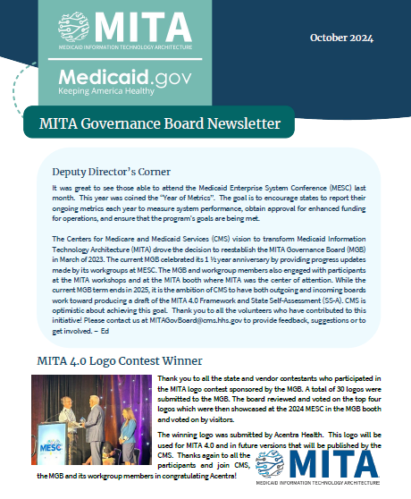
MITA Communications Workgroup Update
Workgroup Leads:
Nicolle Fields
Victoria Cardoza-Kairys
Progress
Updated the MGB GitHub repository for MITA stakeholders: https://cmsgov.github.io/Medicaid-Information-Technology-Architecture-MITA-Repository-Staging/index.html
Preparing communications materials for MESC
Newsletters
FAQs
Next Steps
Publish quarterly newsletter with updates about the development of MITA 4.0
Prepare communications materials for MITA 4.0 adoption

Slide 19
Next Steps
Continue to design and develop SS-A prototype tool, technical assistance resources, and MITA 4.0 Guidance
Engage 2-3 SMAs for user testing and piloting of the SS-A prototype tool, technical assistance resources, and MITA 4.0 Guidance
Post-pilot, adapt materials based on feedback and continue to iterate on developing MITA 4.0
Planning for release of MITA 4.0 and introduction at MESC 2026

Slide 20
Scan the QR code to access the MITA GitHub site to learn more about MITA and keep up to date on MITA 4.0
Send questions and feedback to MITAGovBoard@cms.hhs.gov

